Slide 1
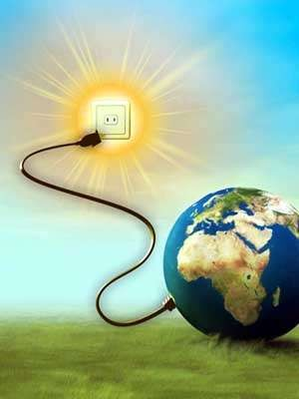
SOLAR POWER GENERATION
(RENEWABLE ENERGY SOURCE)

Slide 2
SOLAR ENERGY:
The energy that is produced from sun is known as solar energy.
The Sun’s energy comes from nuclear fusion reaction that takes place deep in the sun, where hydrogen nucleus fuse into helium nucleus.
When such a reaction takes place then tremendous amount of energy is produced which is escaped into the space.

Slide 3
TYPES OF TECHNOLOGIES IN SOLAR POWER GENERATION:
There are two types of technologies in generating power through solar energy,
They are:
Solar Photovoltaic Technology
Ground mounted solar photovoltaic system (b)Space based solar photovoltaic system
Floating solar chimney technology

Slide 4
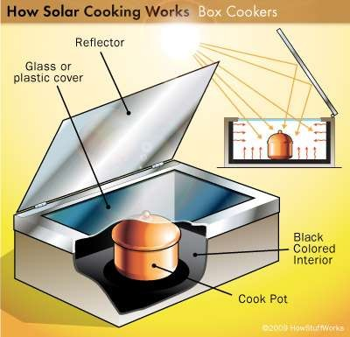
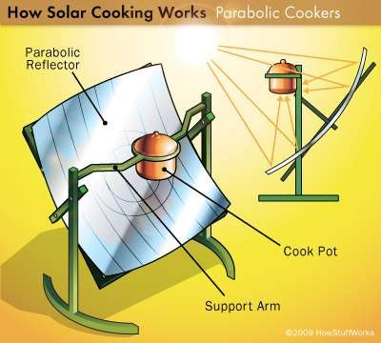
APPLICATIONS :
Solar Cookers:
Box type solar cookers:
Parabolic concentrating solar cookers:

Slide 5
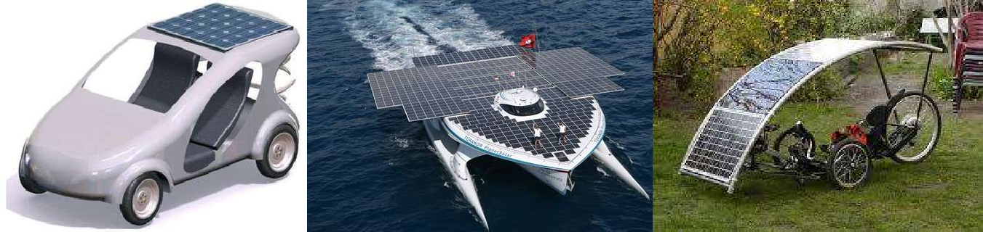
Solar Photovoltaic Cells In Transport:

Slide 6
ADVANTAGES :
Solar energy is almost free of cost.
Solar energy does not cause pollution.
Solar energy can be used in remote areas.
Calculators and other low power consuming devices can be charged.

Slide 7
DIS-ADVANTAGES:
Solar energy can only be harnessed when it is daytime and sunny.
Solar collectors, panels and cells are relatively expensive.
To Built Solar Power plant the cost expenses are too high.

Slide 8
FUTURE SCOPE:
We now have started making use of electric vehicles too.
These vehicles uses solar energy instead of oil.
Their costs are now dropping.
They do not pollute the environment.
They are also cheap in their usage.

Slide 9

ANY QUERIES ???

